Slide 1


12/07/2024
HIRING PROCESS
ANALYTICS
Presented by,
Manu Moolimani

Slide 2

PROJECT DESCRIPTION
The hiring process is a crucial function of any company, and understanding trends such as the number of rejections, interviews, job types, and vacancies can provide valuable insights for the hiring department. By handling the tasks such as checking missing data, and summarizing the data, The aim to enhance the company’s hiring strategies.

Slide 3



APPROACH
The Project involves: Data Cleaning, Clubbing Columns, Outlier Detection, Removing outliers and data summary. These steps allowed us to gain a deeper understanding of the data distribution and derive meaningful insights, which help in improving the hiring strategy.
TECH-STACK
Microsoft Excel: Version 2406, Excel provides powerful data analysis and visualization capabilities, which are ideal for handling data.

Slide 4

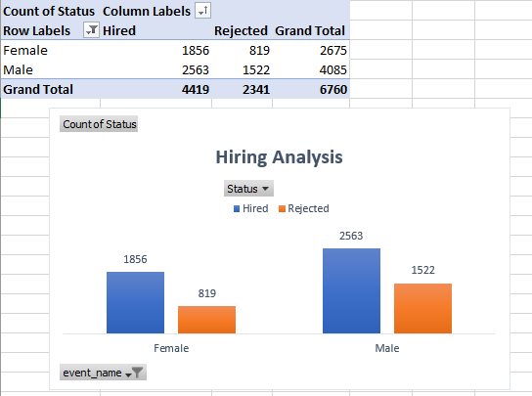

HIRING ANALYSIS
Task was to determine the number of males and females hired by the company, It can be achieved using formula or pivot table.
This insight helps company better understand the number people hired and maintain a good gender balance.

Slide 5
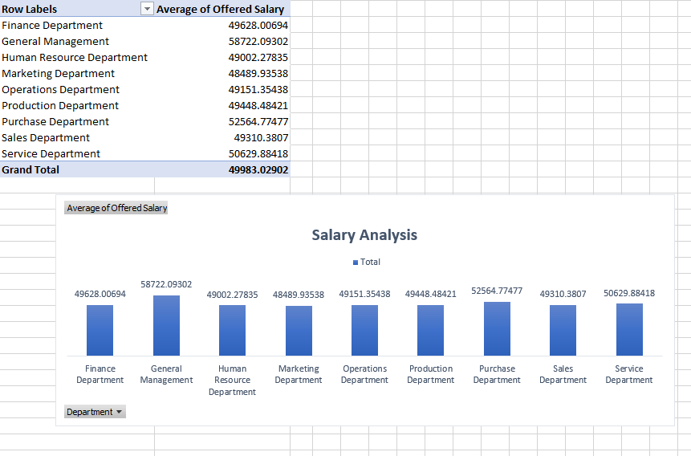
SALARY ANALYSIS
Calculating the average salary offered by the company, this insights can drawn using Excel functions and pivot table.
The average salary offered by the company is $49983.03, this helps in understanding general compensation level in the company.

Slide 6
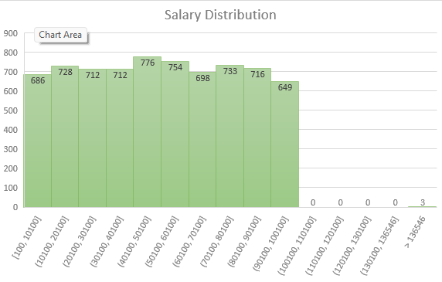
SALARY DISTRIBUTION
The class intervals help in better visualizing the data, that how salary is distributed among the employees.
The histogram is used for better visualization, it can be drawn using the Excel function with filtering each department.

Slide 7
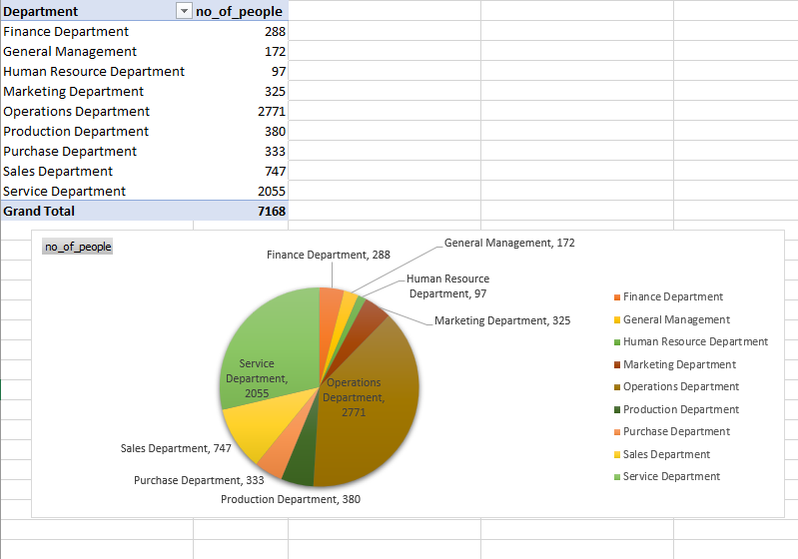
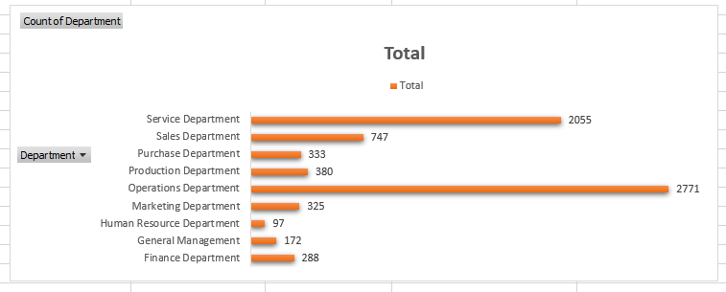
DEPARTMENTAL ANALYSIS
The graphs & pie chart are used to show the portion of people working in different departments.
This insight helps in allocation of resources, pie chart/graph revealed the proportion of people working in different departments.

Slide 8
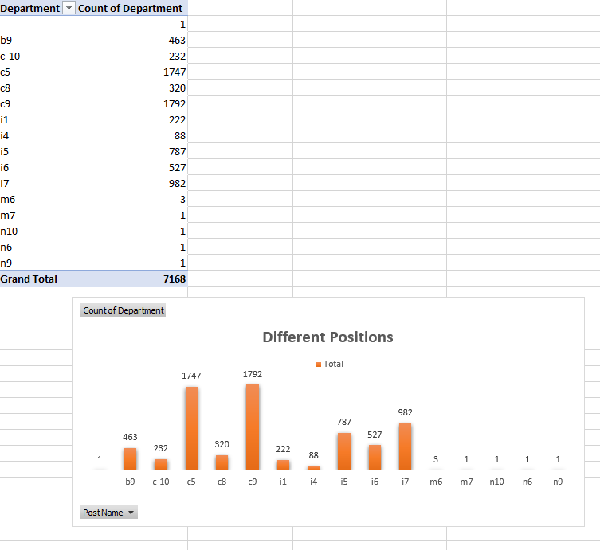
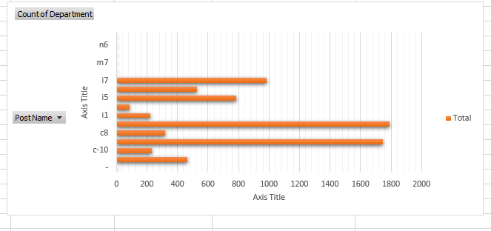
POSTION TIRE ANALYSIS
Analyze different position tiers within the company, It helps in understanding the distribution of the positions across different tires.
Using bar graph, we identify the position tier distribution of the company.

Slide 9

RESULT
The project successfully delivered several significant information, it helped in enhancing my proficiency in data cleaning, data analysis, interpreting results and create effective visualizations. This insights can help streamline recruitment strategies, ensuring better resource allocation and more balanced workforce.

